Slide 1
Data Science Capstone Project
Amir Peikherfeh
https://github.com/amirpeikherfeh/Amirph/tree/main/Upload

Slide 2
Outline
Executive Summary (3)
Introduction (4)
Methodology (6)
Results (16)
Conclusion (46)
Appendix (47)
2

Slide 3
Executive Summary
I collected data from the public SpaceX API and the SpaceX Wikipedia page. I created a "class" column to classify successful landings. The data was explored using SQL, visualizations, folium maps, and dashboards. Relevant columns were selected as features, and all categorical variables were transformed into binary values using one-hot encoding. The data was standardized, and GridSearchCV was applied to identify the best parameters for machine learning models. Accuracy scores for each model were then visualized.
Four machine learning models were built: Logistic Regression, Support Vector Machine, Decision Tree Classifier, and K Nearest Neighbors. All models showed similar results, with an accuracy rate of approximately 83.33%. The models tended to over-predict successful landings. More data is required to improve model accuracy and performance.
3

Slide 4
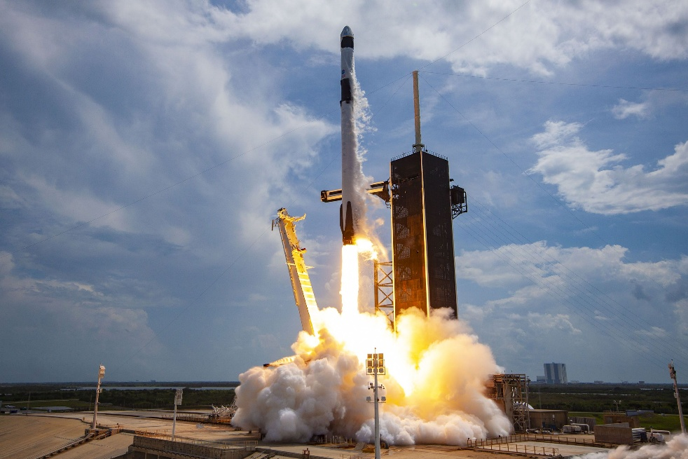
Introduction
Background
The Commercial Space Age has arrived. SpaceX offers the most competitive pricing, charging $62 million compared to $165 million USD. This cost advantage is largely due to SpaceX’s ability to recover the first stage of its rockets. SpaceY is aiming to compete with SpaceX in this emerging market.
Problem
Space Y tasks us to train a machine learning model to predict successful Stage 1 recovery
SpaceX Falcon 9 Rocket – The Verge
4

Slide 5
Data Collection Methodology:
Collected data from the SpaceX public API and SpaceX Wikipedia page.
Conducted data wrangling to clean and preprocess the data.
Classified landings as successful (true landings) and unsuccessful for others.
Performed exploratory data analysis (EDA) using visualizations and SQL.
Applied interactive visual analytics with tools like Folium and Plotly Dash.
Conducted predictive analysis using classification models.
Fine-tuned the models using GridSearchCV to optimize performance.
5

Slide 6
The data collection process involved a combination of API requests to the SpaceX public API and web scraping data from a table in SpaceX’s Wikipedia entry. The next slide will present the flowchart for data collection from the API, and the following one will show the flowchart for data collection from web scraping.
SpaceX API Data Columns:
Flight Number
Date
Booster Version
Payload Mass
Orbit
Launch Site
Outcome
Flights
Grid Fins
Reused
Legs
Landing Pad
Block
Reused Count
Serial
Longitude
Latitude
Wikipedia Web Scraping Data Columns:
Flight No.
Launch Site
Payload
Payload Mass
Orbit
Customer
Launch Outcome
Booster Version
Booster Landing
Date
Time
6

Slide 7
Filter data to only include Falcon 9 launches
Data Collection –SpaceX API
Request (Space X APIs)
Imputate missing PayloadMass values with mean
.JSON file + Lists(Launch Site, Booster Version, Payload Data)
Cast dictionary to a DataFrame
Json_normalize to DataFrame data from JSON
Dictionary relevant data
GitHub url:
Amirph/Upload at main · amirpeikherfeh/Amirph

Slide 8
Data Collection –Web Scraping
Request Wikipedia
html
Cast dictionary to DataFrame
Iterate through table cells to extract data to dictionary
BeautifulSoup
html5lib Parser
Find launch info html table
GitHub url:
Create dictionary
Amirph/Upload at main · amirpeikherfeh/Amirph

Slide 9
Data Wrangling
To create a training label with landing outcomes, the "Outcome" column was split into two components: 'Mission Outcome' and 'Landing Location'.
A new training label column, 'class', was created:
'class' = 1 if the 'Mission Outcome' is True (successful landing).
'class' = 0 if the 'Mission Outcome' is False (failure).
The mapping for the training label was as follows:
True ASDS, True RTLS, and True Ocean were mapped to 1 (successful landings).
None None, False ASDS, None ASDS, False Ocean, and False RTLS were mapped to 0 (unsuccessful landings).
GitHub url:
Amirph/Upload at main · amirpeikherfeh/Amirph

Slide 10
EDA with Data Visualization
Exploratory Data Analysis (EDA) was performed on the following variables: Flight Number, Payload Mass, Launch Site, Orbit, Class, and Year.
The following plots were used to explore relationships between the variables:
Flight Number vs. Payload Mass
Flight Number vs. Launch Site
Payload Mass vs. Launch Site
Orbit vs. Success Rate
Flight Number vs. Orbit
Payload vs. Orbit
Success Yearly Trend
GitHub url:
Amirph/Upload at main · amirpeikherfeh/Amirph

Slide 11
EDA with SQL
The dataset was loaded into the IBM DB2 database and queried using SQL through Python integration. The following types of queries were executed to gain a better understanding of the dataset:
Information about launch site names.
Mission outcomes.
Various payload sizes of customers.
Booster versions.
Landing outcomes.
GitHub url:
Amirph/Upload at main · amirpeikherfeh/Amirph

Slide 12
Build an interactive map with Folium
Folium maps were used to mark the following:
Launch sites
Successful and unsuccessful landings
Proximity to key locations, such as railways, highways, coasts, and cities.
This visualization helps in understanding why launch sites are located in certain areas and provides insights into how successful landings are distributed relative to their locations. It also highlights the influence of proximity to important infrastructure on the landing outcomes.
GitHub url:
Amirph/Upload at main · amirpeikherfeh/Amirph

Slide 13
Build a Dashboard with Plotly Dash
The dashboard includes two key visualizations: a pie chart and a scatter plot.
Pie chart:
Displays the distribution of successful landings across all launch sites.
Can be filtered to show success rates for individual launch sites.
Used to visualize the overall success rate for each launch site.
Scatter plot:
Takes two inputs: all sites or individual sites and payload mass (with a slider between 0 and 10,000 kg).
Helps to visualize how success varies across different launch sites, payload masses, and booster version categories.
These tools allow for a deeper understanding of how factors like payload mass and launch site influence landing success.
GitHub url:
Amirph/Upload at main · amirpeikherfeh/Amirph

Slide 14
Predictive analysis (Classification)
Split label column
Score models on
Confusion Matrix
GitHub url:
Amirph/Upload at main · amirpeikherfeh/Amirph
‘Class’ from dataset
split test set
for all models
Fit and Transform
Use GridSearchCV
Features using
on LogReg, SVM,
Barplot to compare scores of models
Standard Scaler
Decision Tree, and
KNN models
Train_test_split
GridSearchCV
data
(cv=10) to find optimal parameters

Slide 15
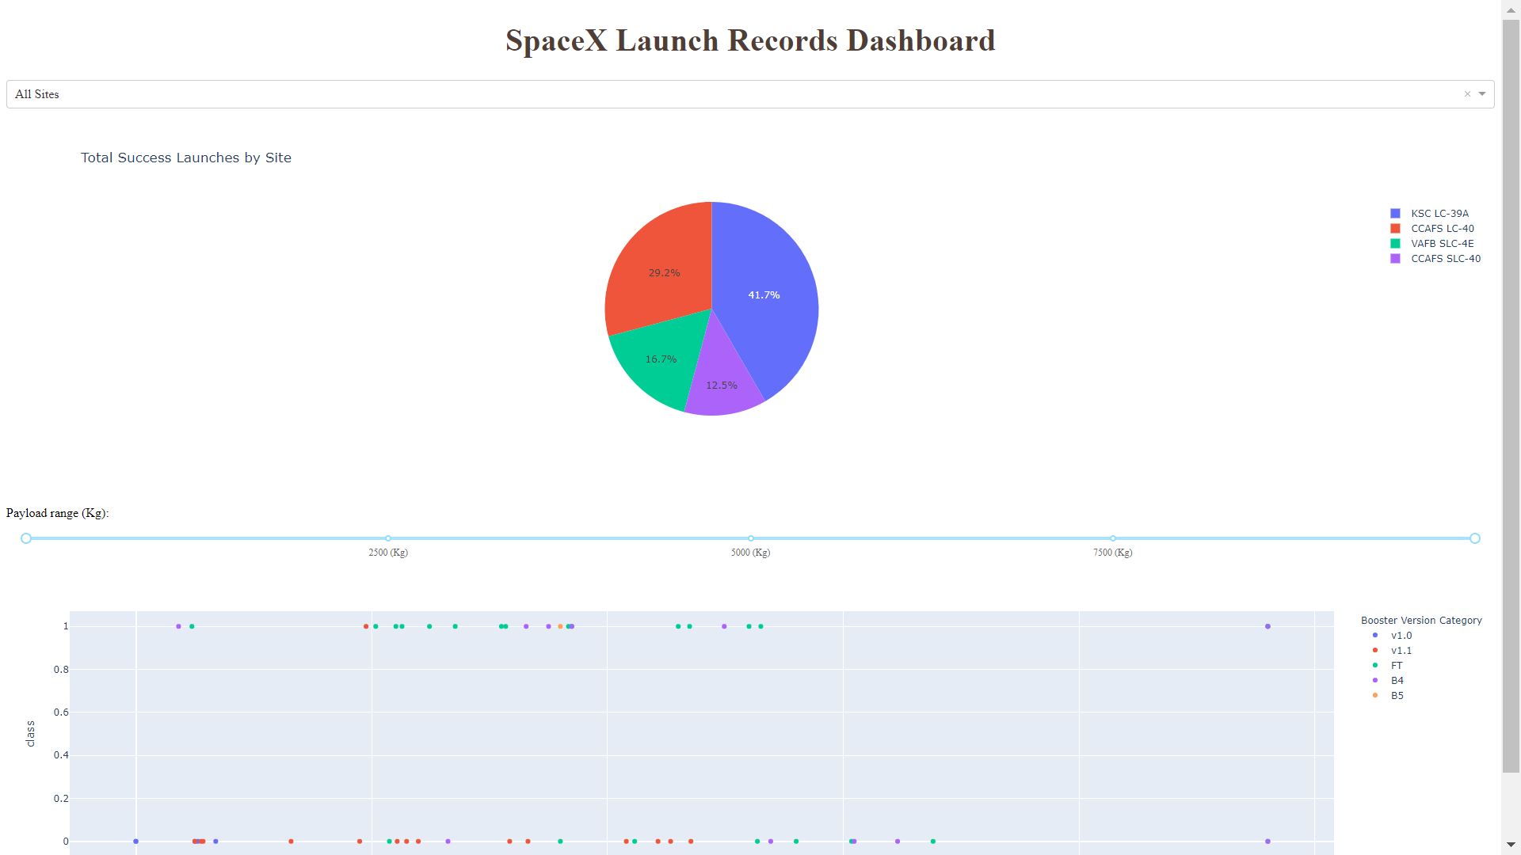
Results
EDA with Visualizations: Insights gained through various plots to understand the data better.
EDA with SQL: SQL queries used to explore the dataset and gather valuable information.
Interactive Map with Folium: A visual representation of launch sites, landing outcomes, and proximity to key locations.
Model Results: The outcomes of our machine learning model, which achieved an accuracy of about 83%.

Slide 16
E D A with Visualization
EXPLORATORY DATA ANALYSIS WITH SEABORN PLOTS

Slide 17
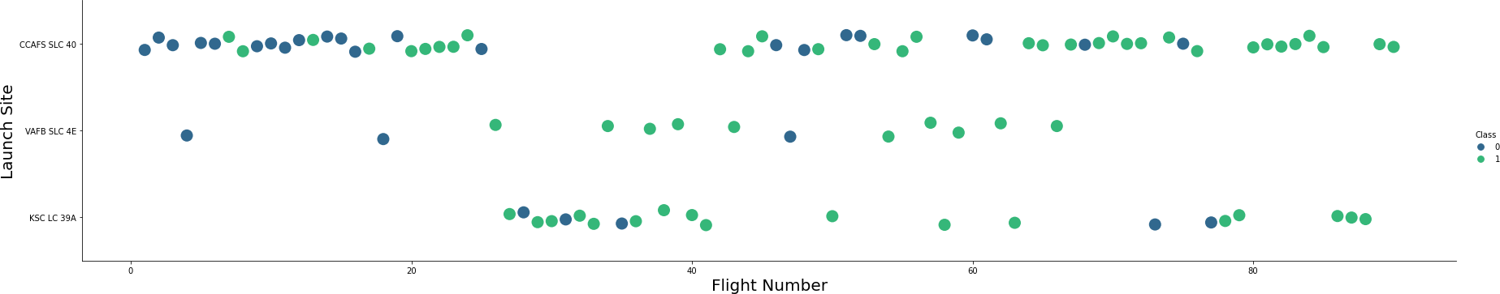
Flight Number vs. Launch Site
Green indicates successful launch; Purple indicates unsuccessful launch.
The graphic suggests an upward trend in the success rate over time, as indicated by the Flight Number. A notable breakthrough around Flight 20 significantly improved the success rate. Additionally, CCAFS (Cape Canaveral Air Force Station) stands out as the primary launch site, as it has the highest launch volume. This indicates that CCAFS may be the most utilized site, contributing to the increased success rates over time.

Slide 18
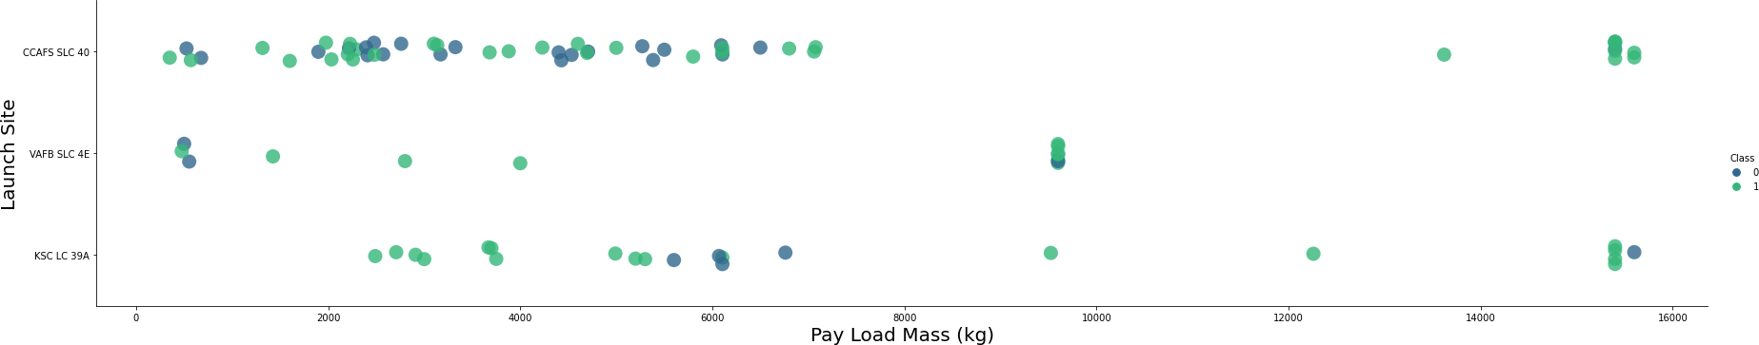
Payload vs. Launch Site
Green indicates successful launch; Purple indicates unsuccessful launch.
The payload mass distribution predominantly falls between 0-6000 kg. Additionally, it appears that different launch sites tend to handle different payload mass ranges. This variation may be due to the specific capabilities or requirements of each site, influencing the types of missions and payloads launched from them.

Slide 19
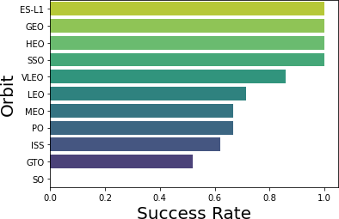
Success rate vs. Orbit type
Success Rate Scale with 0 as 0%
0.6 as 60% 1 as 100%
ES-L1 (1), GEO (1), HEO (1) have 100% success rate (sample sizes in parenthesis) SSO (5) has 100% success rate
VLEO (14) has decent success rate and attempts
SO (1) has 0% success rate
GTO (27) has the around 50% success rate but largest sample

Slide 20
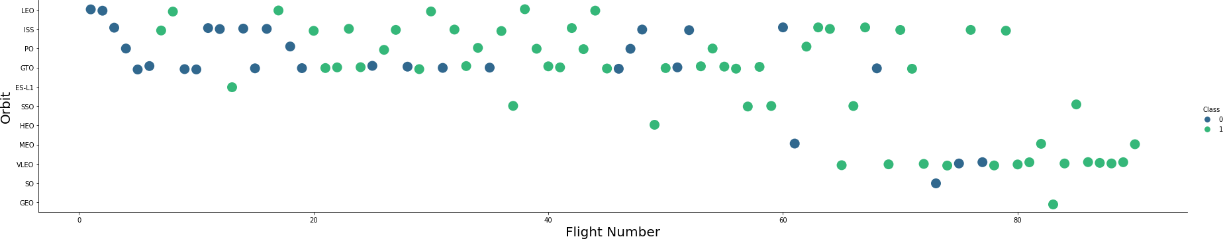
Flight Number vs. Orbit type
Green indicates successful launch; Purple indicates unsuccessful launch.
Launch Orbit preferences changed over Flight Number. Launch Outcome seems to correlate with this preference.
SpaceX started with LEO orbits which saw moderate success LEO and returned to VLEO in recent launches SpaceX appears to perform better in lower orbits or Sun-synchronous orbits

Slide 21
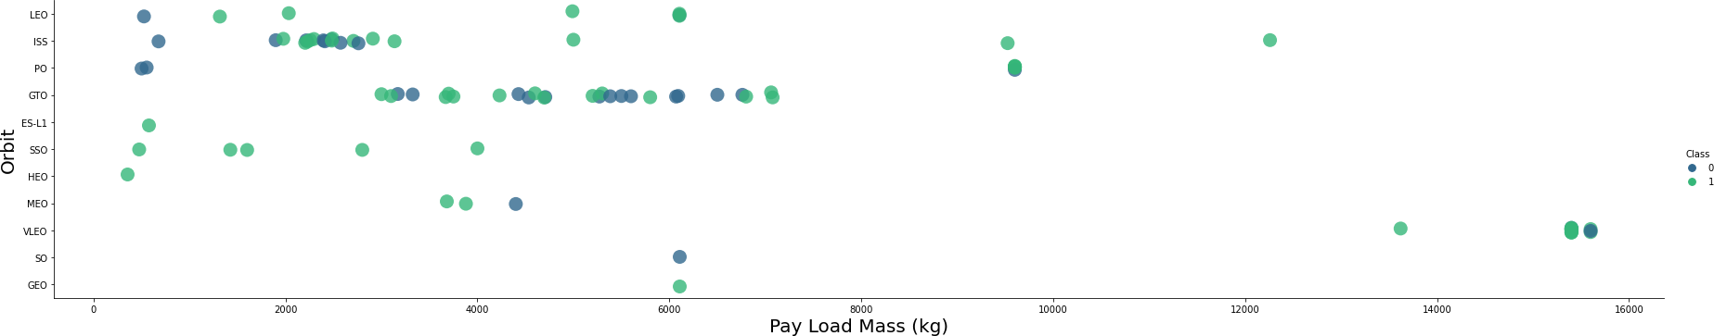
Payload vs. Orbit type
Green indicates successful launch; Purple indicates unsuccessful launch.
Payload mass seems to correlate with orbit
LEO and SSO seem to have relatively low payload mass
The other most successful orbit VLEO only has payload mass values in the higher end of the range

Slide 22
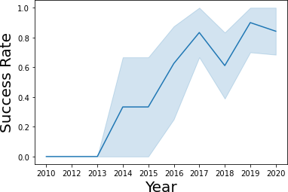
Launch Success Yearly Trend
95% confidence interval (light blue shading)
Success generally increases over time since 2013 with a slight dip in 2018
Success in recent years at around 80%

Slide 23
EDA with SQL
EXPLORATORY DATA ANALYSIS WITH SQL DB2
INTEGRATED IN PYTHON WITH SQLALCHEMY

Slide 24
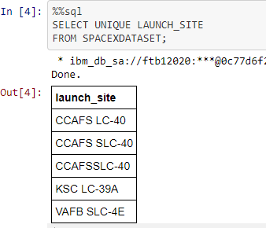
All Launch Site Names
Query unique launch site names from database.
CCAFS SLC-40 and CCAFSSLC-40 likely all represent the same
launch site with data entry errors.
CCAFS LC-40 was the previous name. Likely only 3 unique launch_site values: CCAFS SLC-40, KSC LC-39A, VAFB SLC-4E

Slide 25
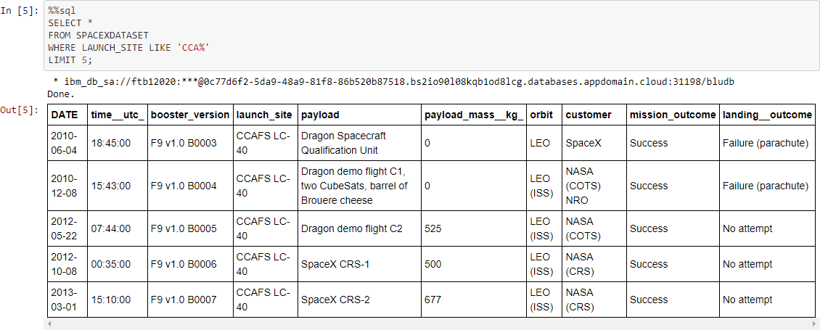
Launch Site Names Beginning with `CCA`
First five entries in database with Launch Site name beginning with CCA.

Slide 26
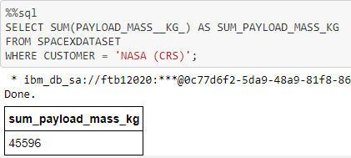
Total Payload Mass from NASA
This query sums the total payload mass in kg where NASA was the customer.
CRS stands for Commercial Resupply Services which indicates that these payloads were sent to the International Space Station (ISS).

Slide 27
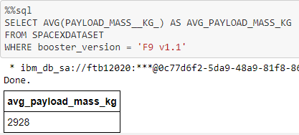
Average Payload Mass by F9 v1.1
This query calculates the average payload mass or launches which used booster version F9 v1.1
Average payload mass of F9 1.1 is on the low end of our payload mass range

Slide 28
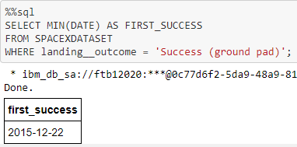
First Successful Ground Pad Landing Date
This query returns the first successful ground pad landing date.
First ground pad landing wasn’t
until the end of 2015.
Successful landings in general
appear starting 2014.

Slide 29
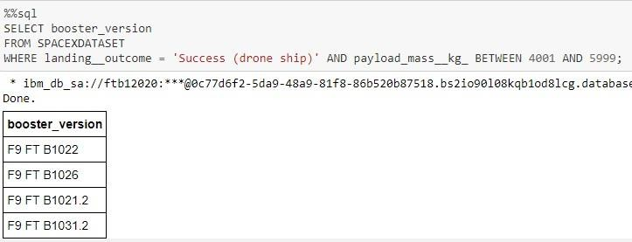
Successful Drone Ship Landing with Payload Between 4000 and 6000
This query returns the four booster versions that had successful drone ship landings and a payload mass between 4000 and 6000 noninclusively.

Slide 30
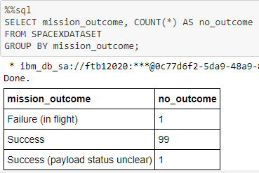
Total Number of Each Mission Outcome
This query returns a count of each
mission outcome.
SpaceX appears to achieve its mission outcome nearly 99% of the time.
This means that most of the landing
failures are intended.
Interestingly, one launch has an unclear payload status and unfortunately one failed in flight.

Slide 31
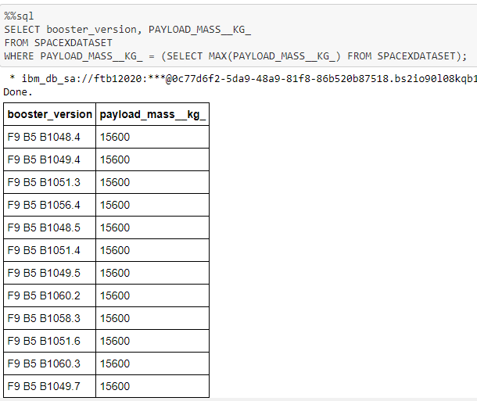
Boosters that Carried Maximum Payload
This query returns the booster versions that carried the highest payload mass of 15600 kg.
These booster versions are very similar and all are of the F9 B5 B10xx.x variety.
This likely indicates payload mass correlates with the booster version that is used.

Slide 32
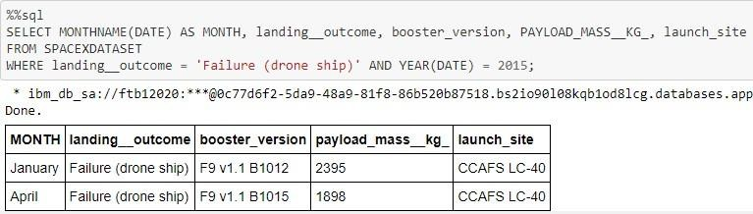
2015 Failed Drone Ship Landing Records
This query returns the Month, Landing Outcome, Booster Version, Payload Mass (kg), and Launch site of 2015 launches where stage 1 failed to land on a drone ship.
There were two such occurrences.

Slide 33
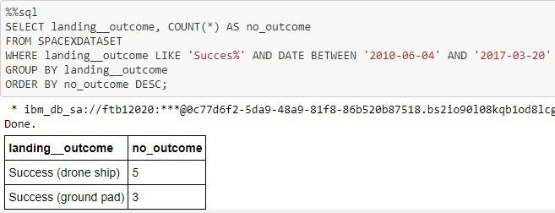
Ranking Counts of Successful Landings Between 2010-06-04 and 2017-03-20
This query returns a list of successful landings and between 2010-06-04 and 2017-03-20 inclusively.
There are two types of successful landing outcomes: drone ship and ground pad landings.
There were 8 successful landings in total during this time period

Slide 34
Interactive Map with Folium

Slide 35
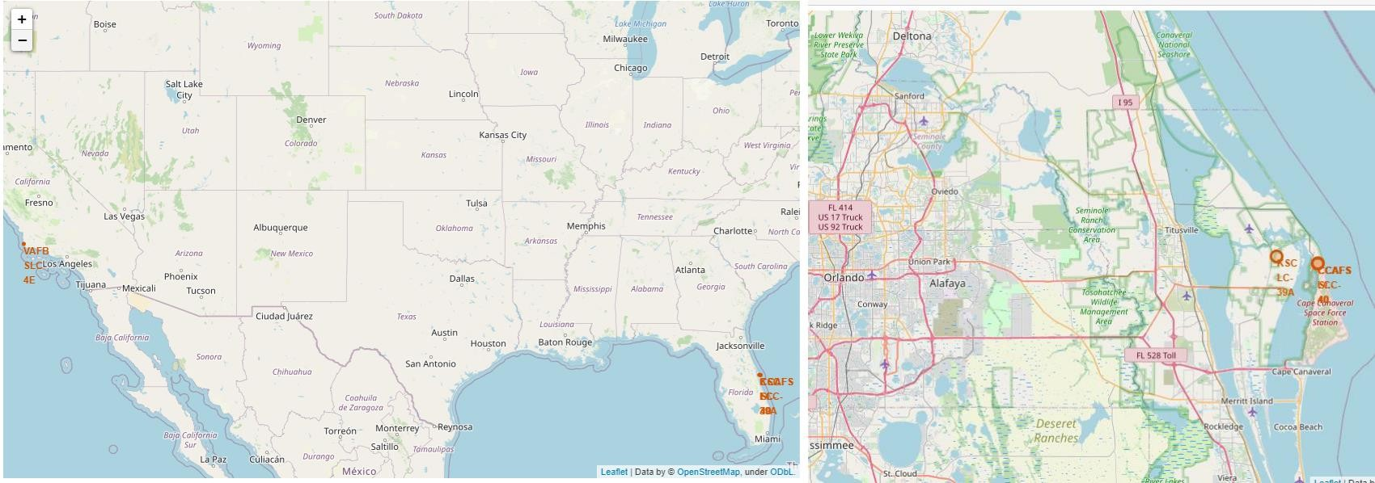
Launch Site Locations
The left map shows all launch sites relative US map. The right map shows the two Florida launch sites since they are very close to each other. All launch sites are near the ocean.

Slide 36
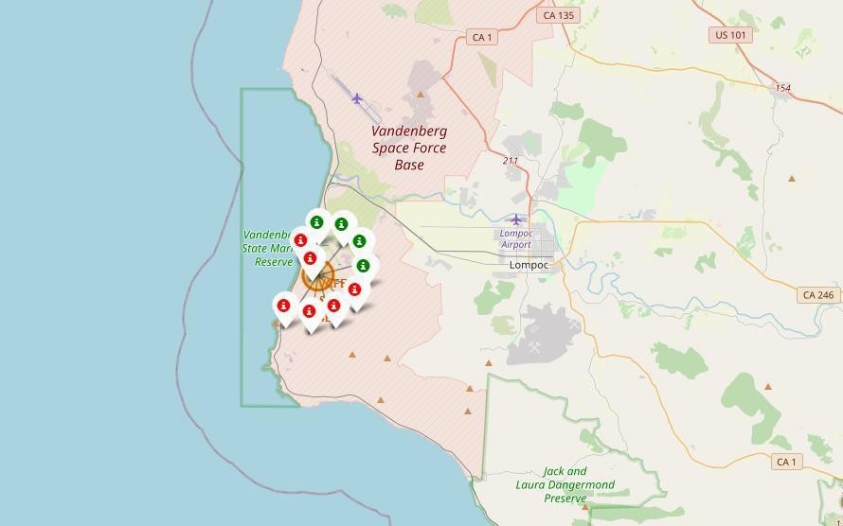
Color-Coded Launch Markers
Clusters on Folium map can be clicked on to display each successful landing (green icon) and failed
landing (red icon). In this example VAFB SLC-4E shows 4 successful landings and 6 failed landings.

Slide 37
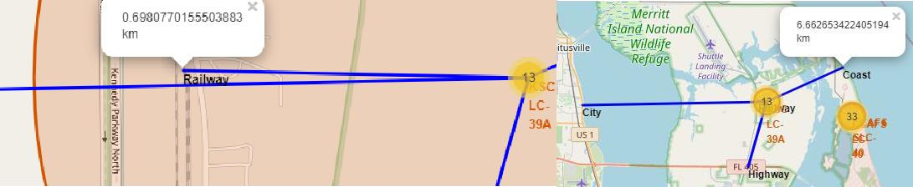
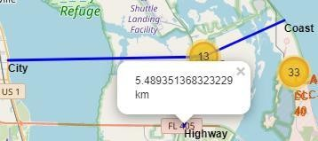
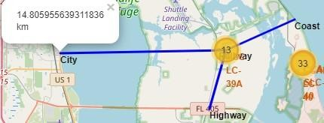
Key Location Proximities
Using KSC LC-39A as an example, launch sites are very close to railways for large part and supply transportation. Launch sites are close to highways for human and supply transport. Launch sites are also close to coasts and relatively far from cities so that launch failures can land in the sea to avoid rockets falling on densely populated areas.

Slide 38
Build a Dashboard with Plotly Dash

Slide 39
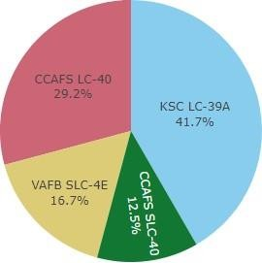

Successful Launches Across Launch Sites
This is the distribution of successful landings across all launch sites. CCAFS LC-40 is the old name of CCAFS SLC-40 so CCAFS and KSC have the same amount of successful landings, but a majority of the successful landings where performed before the name change. VAFB has the smallest share of successful landings. This may be due to smaller sample and increase in difficulty of launching in the west coast.

Slide 40
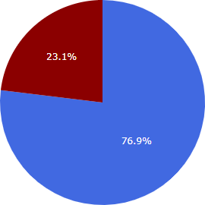

Highest Success Rate Launch Site
KSC LC-39A has the highest success rate with 10 successful landings and 3 failed landings.

Slide 41
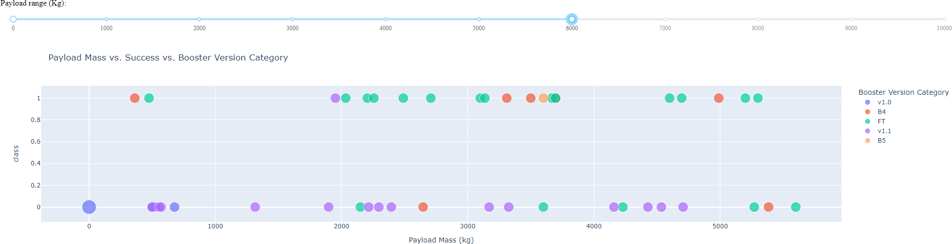
Payload Mass vs. Success vs. Booster Version Category
Plotly dashboard has a Payload range selector. However, this is set from 0-10000 instead of the max Payload of 15600. Class indicates 1 for successful landing and 0 for failure. Scatter plot also accounts for booster version category in color and number of launches in point size. In this particular range of 0-6000, interestingly there are two failed landings with payloads of zero kg.

Slide 42
Predictive Analysis (Classification
GRIDSEARCHCV(CV=10) ON LOGISTIC REGRESSION, SVM, DECISION
TREE, AND KNN

Slide 43
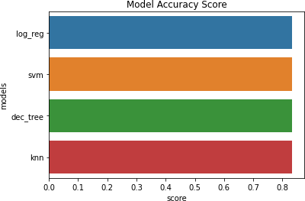
Classification Accuracy
All models had virtually the same accuracy on the test set at 83.33% accuracy. It should be noted that test size is small at only sample size of 18.
This can cause large variance in accuracy results, such as those in Decision Tree Classifier model in repeated runs.
We likely need more data to determine the best model.

Slide 44
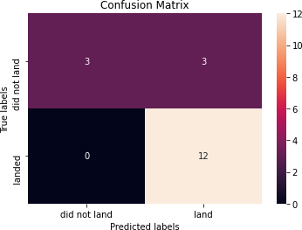
Confusion Matrix
Correct predictions are on a diagonal from top left to bottom right.
Since all models performed the same for the test set, the confusion matrix is the same across all models. The models predicted 12 successful landings when the true label was successful landing.
The models predicted 3 unsuccessful landings when the true label was unsuccessful landing.
The models predicted 3 successful landings when the true label was unsuccessful landings (false positives). Our models over predict successful landings.

Slide 45
CONCLUSION
Our task: to develop a machine learning model for Space Y who wants to bid against SpaceX
The goal of model is to predict when Stage 1 will successfully land to save ~$100 million USD
Used data from a public SpaceX API and web scraping SpaceX Wikipedia page
Created data labels and stored data into a DB2 SQL database
Created a dashboard for visualization
We created a machine learning model with an accuracy of 83%
Allon Mask of SpaceY can use this model to predict with relatively high accuracy whether a launch will have a successful Stage 1 landing before launch to determine whether the launch should be made or not
If possible more data should be collected to better determine the best machine learning model and improve accuracy

Slide 46
APPENDIX
GitHub repository url:
Amirph/Upload at main · amirpeikherfeh/Amirph
Instructors:
Instructors: Rav Ahuja, Alex Aklson, Aije Egwaikhide, Svetlana Levitan, Romeo Kienzler, Polong Lin, Joseph Santarcangelo, Azim Hirjani, Hima Vasudevan, Saishruthi Swaminathan, Saeed Aghabozorgi, Yan Luo
Special Thanks to All Instructors:
https://www.coursera.org/professional-certificates/ibm-data-science?#instructors

